Slide 1
Multimodal Learning on Chest X-ray diagnosis
Richard

Slide 2
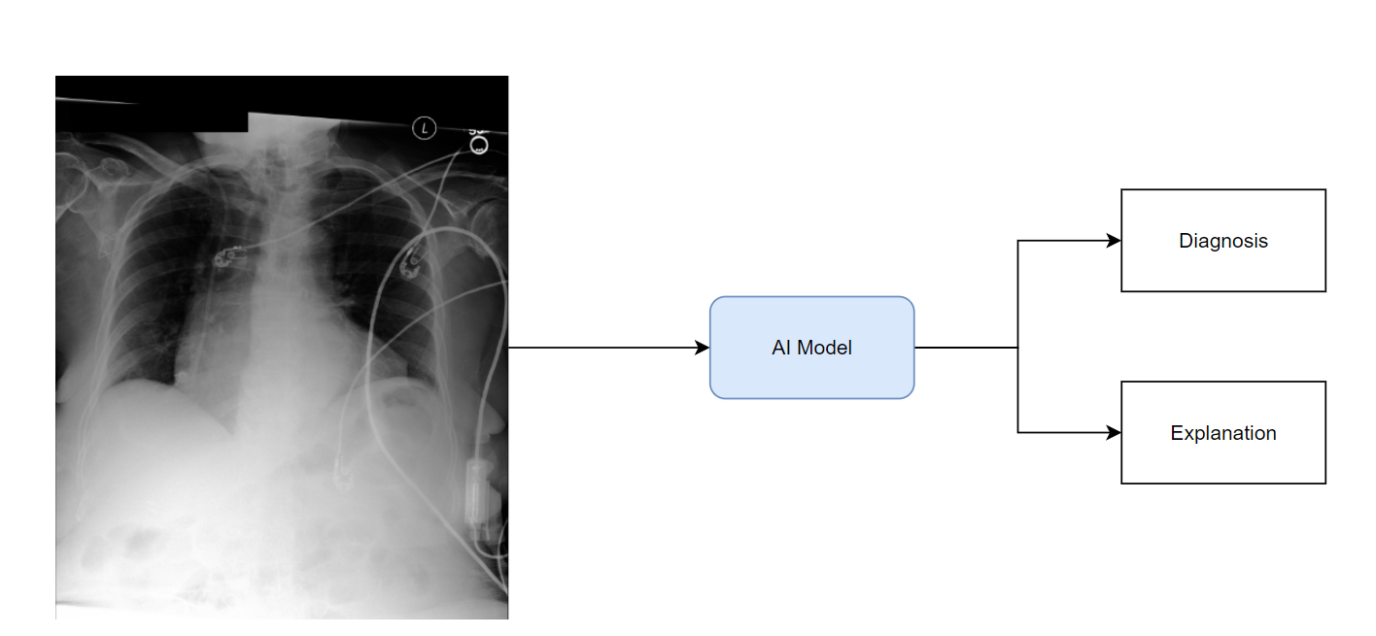
What’s the AI supposed to do?

Slide 3
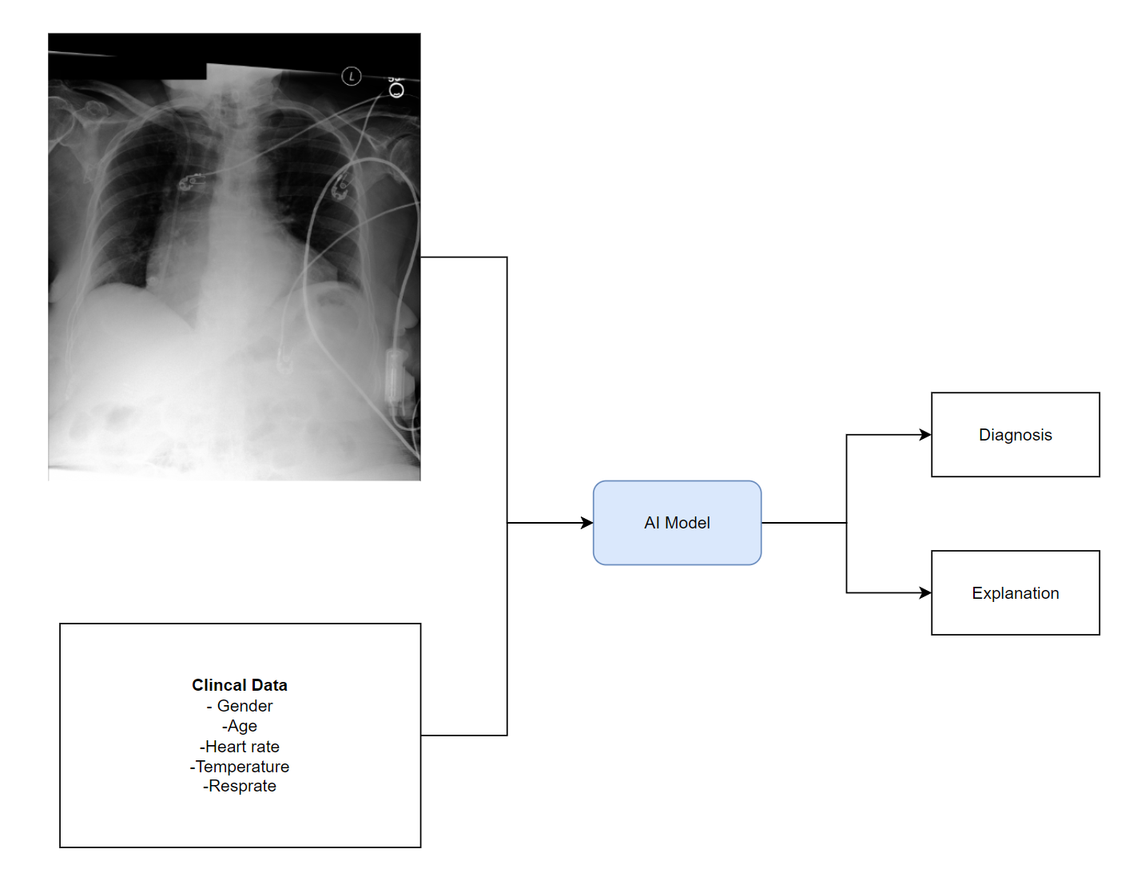
What’s Multimodal learning
GradCAM++
Radiologists think clinical data is essential for them to make a proper diagnosis.
Is it the same case for machine?

Slide 4
The question we’re trying to answer:
Does it provide a better performance?
Does it promote the explainability?

Slide 5
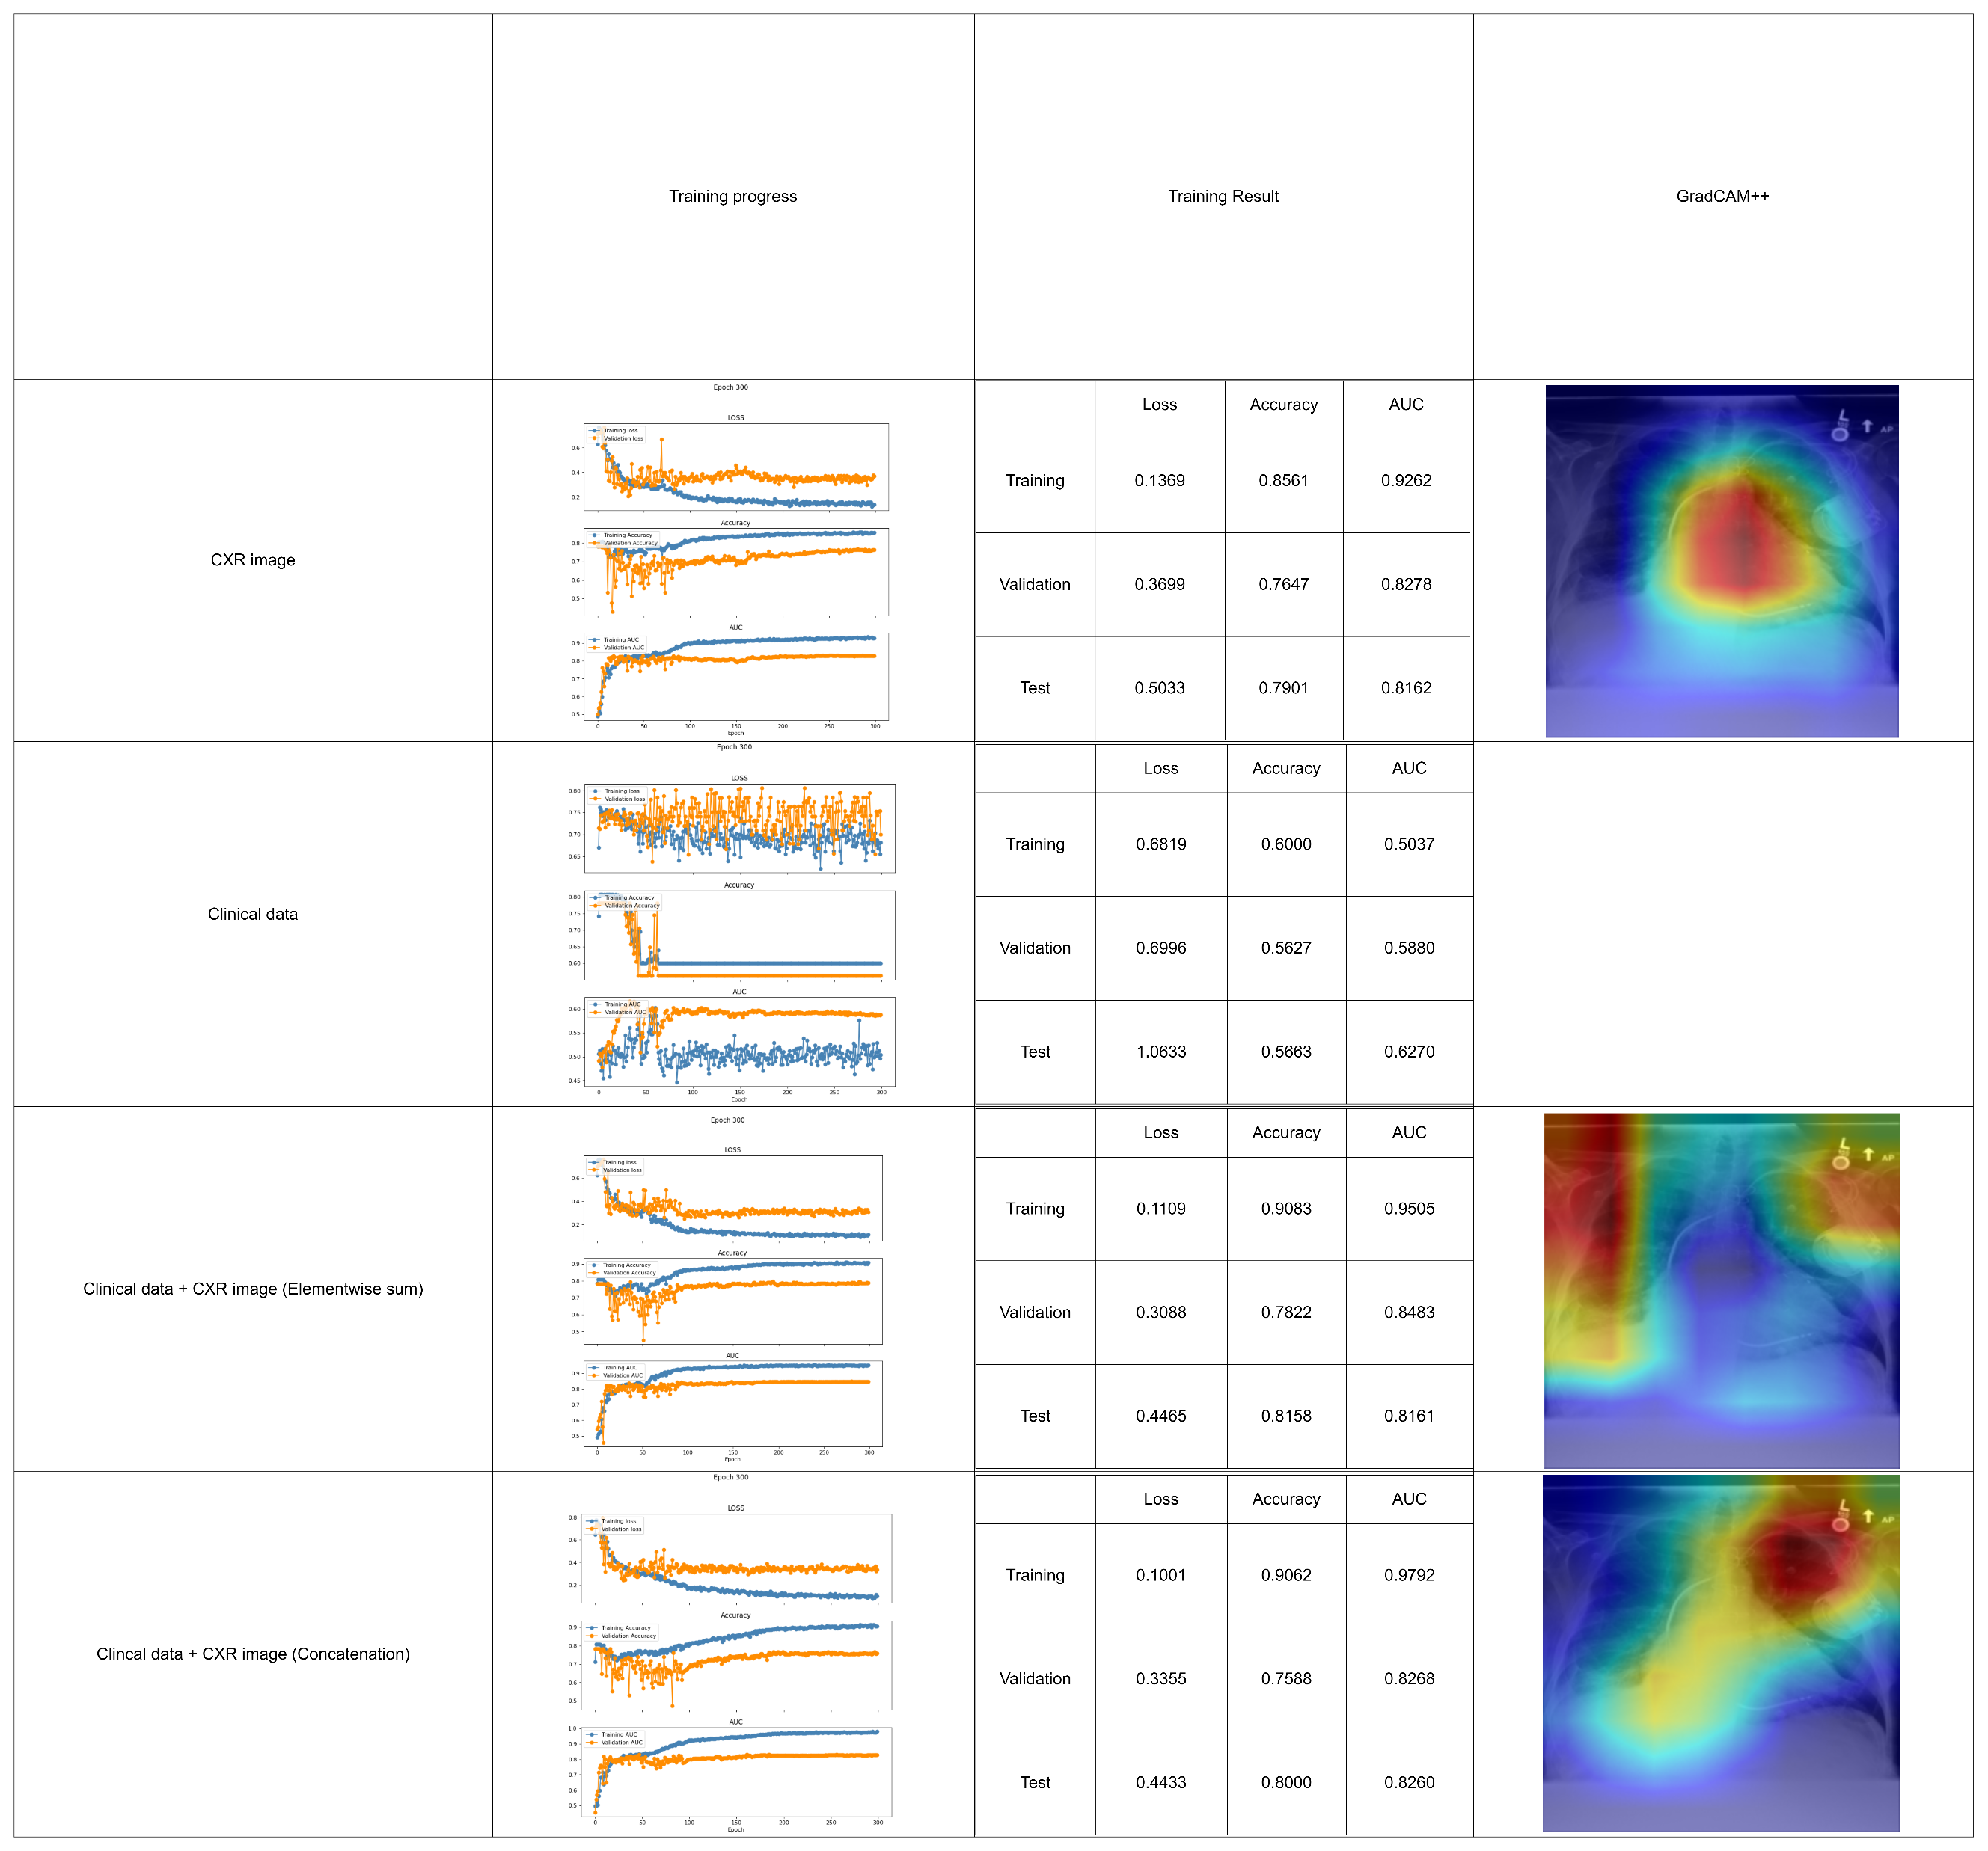
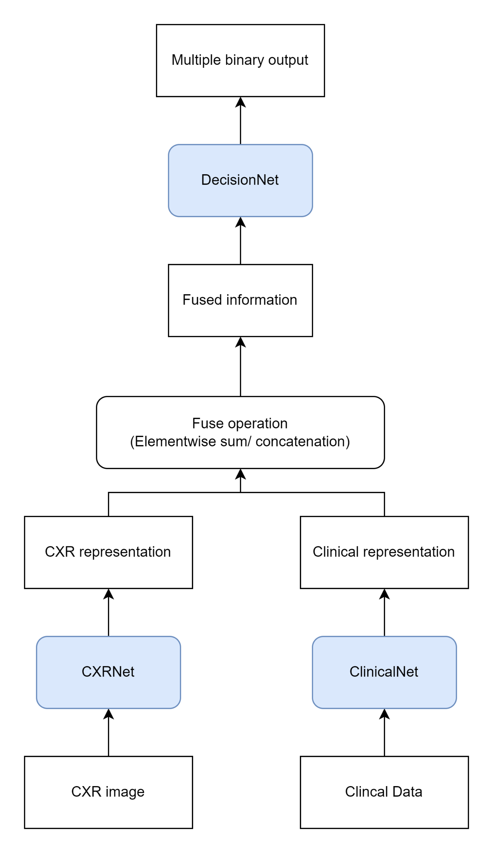
Previously,
Couldn’t get bounding boxes from heatmap.
Notes:
Possible solution:

Slide 6
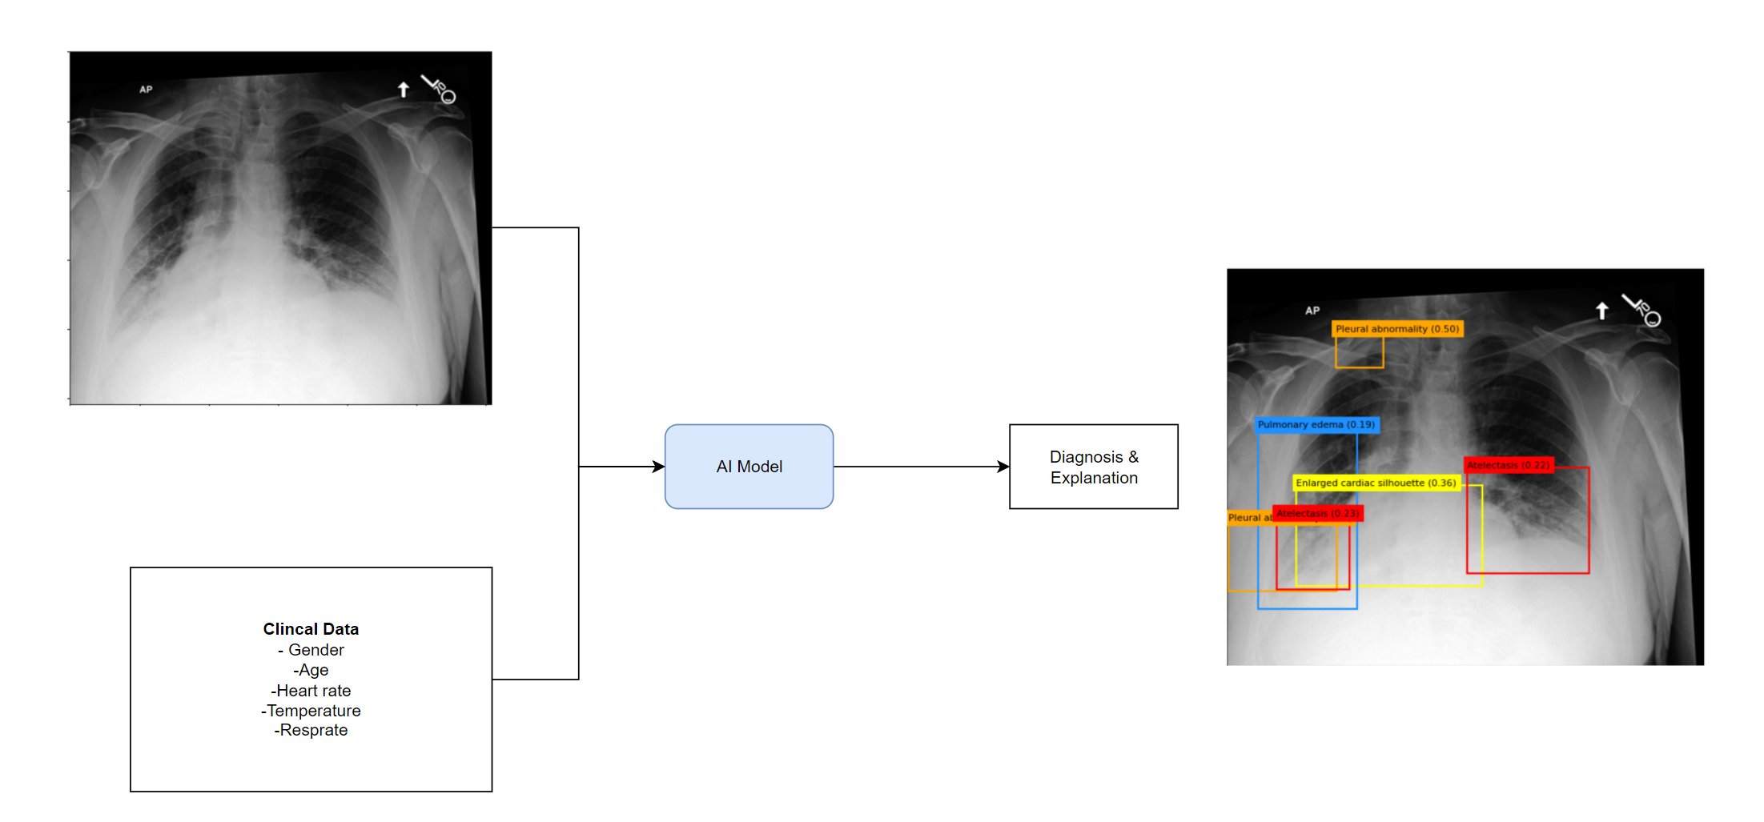
Another solution: Object (Lesion) Detection
Mask R-CNN

